Slide 1
Optimizing Out-of-Order Processor Efficiency and Reliability through Novel Architectural Techniques
Student Name: Neeraj Reddy Aluka,
Harshith Reddy Musalireddy Garu,
Nikhila Polkampally

Slide 2
CONTENTS
Introduction
1
Introduction and Objectives
An overview of Out-of-Order (OoO) processors and the goals of enhancing their efficiency and reliability.
2
Advanced Architectural Techniques
Detailed exploration of register allocation, VDD-gating algorithms, and replace-free instruction set architecture.
3
Fault Mitigation Strategies
Analysis of techniques to improve processor reliability through error correction and redundancy.
Conclusions and Future Work
4
Summary of findings and potential future research directions in optimizing OoO processors.

Slide 3

INTRODUCTION
Overview
Out-of-Order (OoO) processors execute instructions based on resource availability rather than program order.
Significance
Enhances computational efficiency by optimizing resource utilization.
Importance
Critical for meeting the demands of modern, power-sensitive, and data-intensive applications.

Slide 4
The goal of the presentation is to enhance efficiency and reliability of OoO processors.
Key Focus Areas
Register Allocation: Optimize usage and reduce power consumption using priority encoding.
Power Management: Implement advanced VDD-gating techniques for dynamic power control.
Fault Mitigation: Use ECC and redundancy techniques to detect and correct faults.

Slide 5


Advanced Register Allocation & VDD-Gating Algorithms
Fine-Grained Gating: Controls power at the individual register level.
Coarse-Grained Gating: Manages power at the bank level.
Priority Encoding: Ensures efficient selection of registers.
Free-List Allocation: Utilizes a FIFO queue for effective management.
Most Recently Used (MRU): Allocates registers that have been recently used.
VDD-Gating Methods:
Register Allocation Techniques
Power Savings: Significant reduction in leakage power.
Performance Improvement: Enhanced execution efficiency.
Benefits

Slide 6
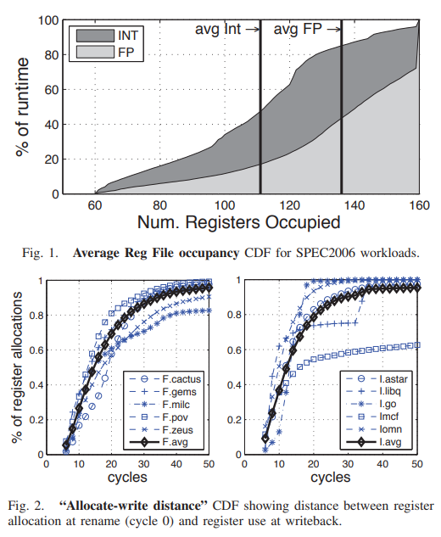
Evaluation of Register Allocation & VDD-Gating
Methodology
Utilized cycle-level performance simulators.
Employed HSPICE for circuit simulations.
Key Results
Fine-grained gating achieved up to 50% leakage energy savings.
Coarse-grained gating provided additional benefits under specific conditions.
Pros and Cons
Pros:
Significant power savings.
Adaptable to different register file sizes and configurations.
Cons:
Increased circuit complexity for fine-grained gating.
Potential performance impacts due to gating operations.

Slide 7
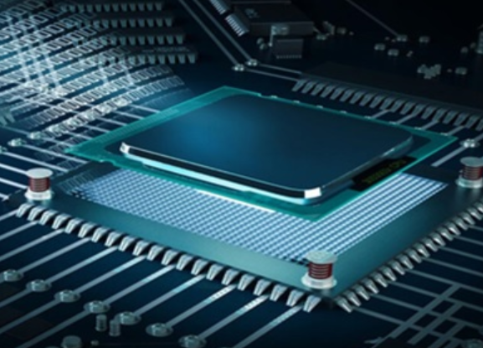
Replace-Free Instruction Set Architecture (ISA)
Techniques:
Replace-Free ISA
Avoids the need for substituting instructions, simplifying control logic.
Reduced Instruction Set Computing (RISC)
Simplifies processor design, enabling more efficient execution.
Pipeline Optimization
Minimizes delays and reduces overall power usage.
Benefits:
Simplified design
Easier to implement and manage, reducing complexity.
Reduced power consumption
Less energy required for instruction fetch and decode stages.
Improved execution speed
Faster processing of instructions, enhancing overall performance.

Slide 8
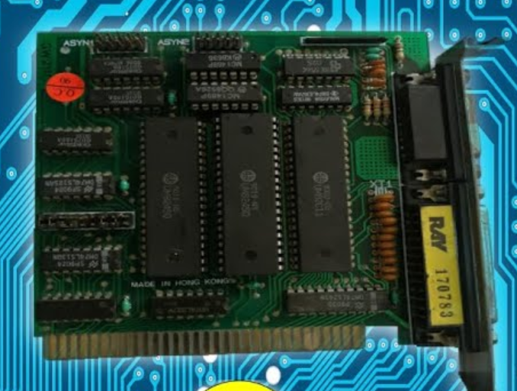
Evaluation of Replace-Free ISA
Method:
Performance benchmarks
Utilized to assess the efficiency of the proposed architecture.
Measured execution speed and power consumption.
Results:
Improvements in execution speed
Simplified pipeline stages contributed to faster instruction processing.
Reduced complexity in control logic enhanced overall performance.
Enhanced power efficiency
Replace-free ISA eliminated the need for instruction substitution, reducing power usage.
Optimized design of execution units and pipeline stages led to lower energy consumption.

Slide 9

Intermittent Fault Mitigation
Techniques:
Error Correction Codes (ECC)
Utilized to detect and correct intermittent faults within registers and memory.
Redundancy Techniques
Deploying redundant execution units and logic to dynamically detect and correct faults.
Fault Injection and Reliability Analysis
Simulating various fault scenarios to understand their impact.
Using statistical methods to predict fault likelihood and impact on system reliability.
Benefits:
Enhanced reliability
Increased operational lifespan under various conditions.
Effective fault detection and correction
Real-time detection and correction of issues, ensuring higher reliability.
Improved fault tolerance
Greater resilience against intermittent faults, enhancing overall processor robustness.

Slide 10

Evaluation of Fault Mitigation Techniques
Method:
Extensive simulations conducted to evaluate fault mitigation techniques.
Simulated various fault scenarios to assess effectiveness.
Utilized statistical analysis to measure fault detection and correction capabilities.
Results:
Significant improvement in fault detection
Error Correction Codes (ECC) effectively detected and corrected intermittent faults.
Redundancy techniques identified discrepancies and corrected faults dynamically.
Enhanced fault correction capabilities
Simulations demonstrated a reduction in fault rates, enhancing overall processor reliability.
Statistical analysis provided insights into fault likelihood and impact, guiding reliability improvements.

Slide 11
Summary of Pros & Cons of each Method
Technique | Pros | Cons
Register Allocation and VDD-Gating | Significant power savings, adaptable to different configurations | Increased circuit complexity for fine-grained gating, potential performance impacts
Replace-Free ISA | Simplified design, reduced power consumption, improved execution speed | Potential limitations in handling complex instruction sets, significant redesign required
Intermittent Fault Mitigation | Improved reliability, effective fault detection and correction mechanisms | Increased hardware complexity, potential performance overhead

Slide 12
Conclusions
Integration of Techniques:
Combining advanced register allocation and VDD-gating
Achieves significant power savings through dynamic management of register file usage.
Implementing replace-free ISA and pipeline optimization
Simplifies design, reduces power consumption, and improves execution speed.
Incorporating robust fault mitigation strategies
Enhances reliability with effective fault detection and correction mechanisms.

Slide 13

Overall benefits
Power savings
Dynamic register allocation and fine-grained gating reduce leakage energy.
Performance enhancement
Simplified ISA and optimized pipeline stages boost execution speed and efficiency.
Improved fault tolerance
Fault detection and correction techniques ensure higher reliability and robustness in varied operating conditions.

Slide 14
Future Work
Areas for Further Research | Details
Enhanced power management | Investigate adaptive power management strategies using machine learning algorithms. Implement finer granularity in power gating to optimize energy efficiency.
Advanced fault tolerance | Explore new error detection codes beyond traditional ECC, such as probabilistic approaches. Develop dynamic reconfiguration methods to improve system resilience.
Integration of emerging memory | Study the use of non-volatile memory (NVM) for caching and main memory.
technologies | Research hybrid memory architectures combining NVM with traditional DRAM.
Security enhancements | Develop hardware-based security features to protect against side-channel attacks. Explore hardware-enforced memory encryption and integrity verification techniques.
Scalability and parallelism | Enhance inter-core communication, workload distribution, and resource allocation across multiple cores. Address synchronization overhead and cache coherence issues in scalable OoO processor architectures.

Slide 15
References
"Register Allocation and VDD-Gating Algorithms for Out-of-Order Architectures," in 2013 IEEE 31st International Conference on Computer Design (ICCD), 2013. Available: https://ieeexplore.ieee.org/document/6657032
"Clockhands: Rename-free Instruction Set Architecture for Out-of-order Processors," in MICRO 2023, Oct. 28-Nov. 1, 2023. Available: https://ieeexplore.ieee.org/document/10411360
"Effects of Intermittent Faults on the Reliability of a Reduced Instruction Set Computing (RISC) Microprocessor," in IEEE Transactions on Reliability, vol. 63, no. 1, Mar. 2014. Available: https://ieeexplore.ieee.org/document/6722985

Slide 16
THANK YOU

